Slide 1
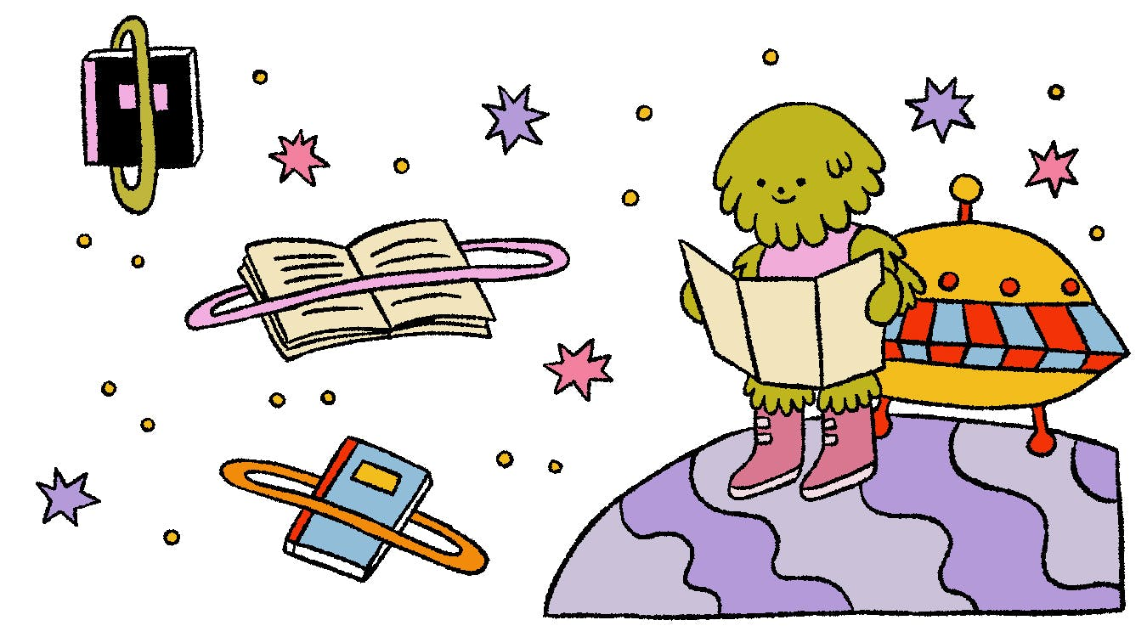
Trapped in the Library
TD Summer Reading Club Escape Game
Notes:
Staff:
Click on the Slide Show tab and click From Beginning.
You may want to ask students to have a pencil and paper available for the riddles

Slide 2
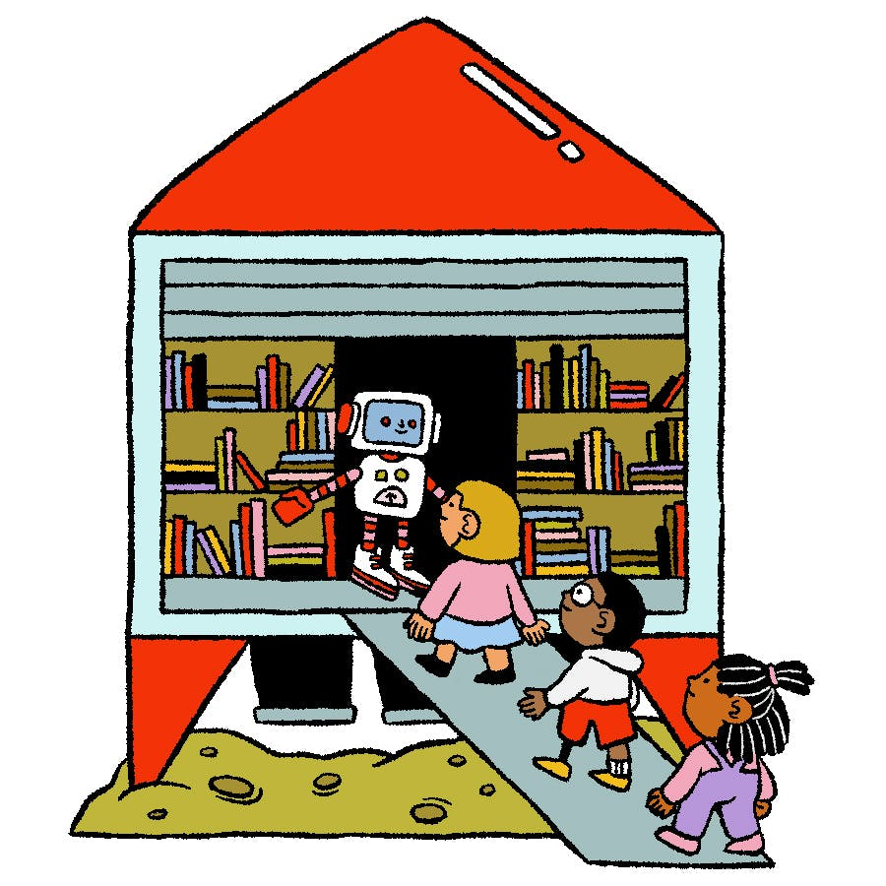
It’s late on a summer evening, and you’re walking home from swimming.
You’re late for dinner and rushing back when you see some kids walking into a building that looks like a rocket filled with books.
“That’s strange,” you think to yourself. “I didn’t know there was a library here.” Your curiosity pulls you in.
As you enter the library, you close the door behind you.
You hear a twinkling sound, and the door disappears.

Slide 3
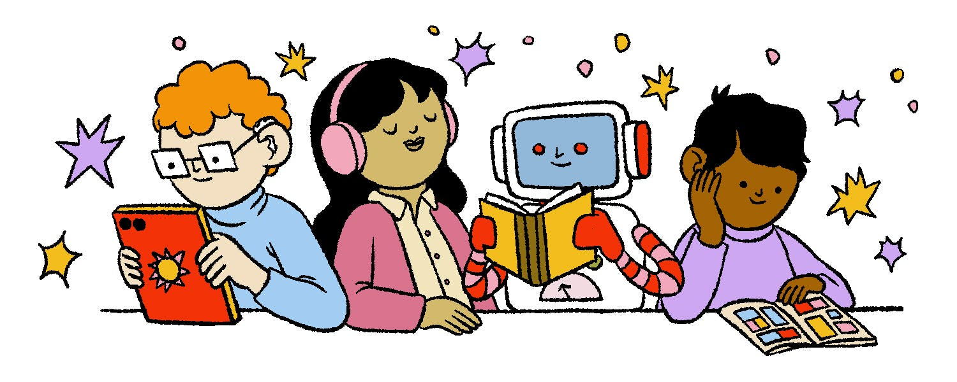
The library is quiet even though there are customers.
You try to ask them what happened to the door, but
no one reacts. They are holograms!
You walk down the stairs and see a long hallway. The first door on your left has the words “Come in” written on it. You grasp the doorknob and slowly turn it.

Slide 4
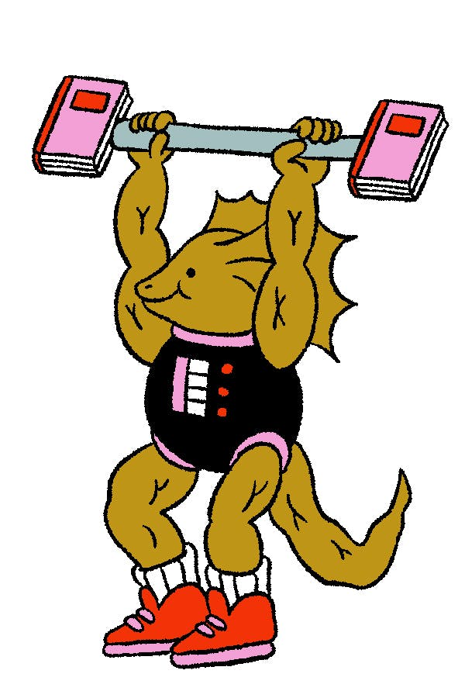
You open the door and are shocked to see a lizard-like creature lifting book weights.
“Oh, hello!” the creature exclaims. “Welcome to the overnight library. The more you read, the bigger your muscles get!
”You’re welcome to spend the night here working out … I mean … reading, if you want!”

Slide 5

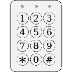
“Uh, no thanks,” you say. “Do you know how I can get out of here? My parents are expecting me home.”
“The only other exit is at the end of this long hallway,” the creature replies. “But no one has been able to figure out the combination for the keypad. You’d better get going before the library launches into space!”
“OK, thanks!” you say. You quietly shut the door and walk to the end of the hallway.
EXIT

Slide 6
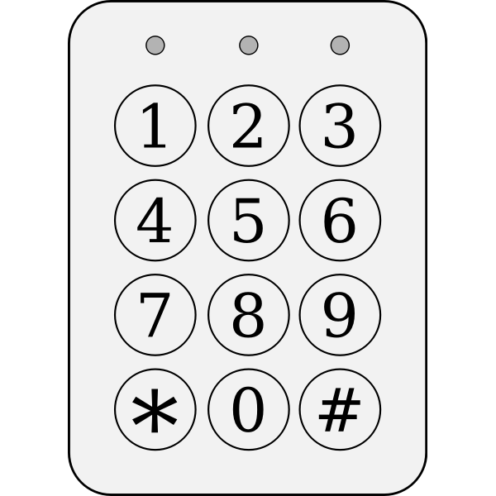
You reach the door. You see the keypad and a riddle.
Enter the next two numbers in the sequence to unlock the door:
90, 85, 75, 60, ___ , ___
Click here for a hint
Click here to try the keypad

Slide 7
90, 85, 75, 60, ___ , ___
The numbers are decreasing in a pattern: first by 5 (from 90 to 85), then by 10 (from 85 to 75), and then by 15 (from 75 to 60).
So, if the next two numbers follow that pattern, the correct answer should be…
Click here for another hint
Click here to try the keypad

Slide 8
Let’s have a closer look:
90, 85, 75, 60, ___ , ___
The numbers are decreasing in a pattern: first by 5 (from 90 to 85), then by 10 (from 85 to 75), and then by 15 (from 75 to 60). So, that means the next number should decrease by 20 (60-20=?).
And, finally, the last number in the sequence will decrease from that by 25!
90, 85, 75, 60, ___ , ___
Click here to try the keypad

Slide 9
90, 85, 75, 60, ___ , ___
Click on a set of numbers to enter into the keypad
50, 35
40, 20
66, 65
30, 10
45, 30
40, 15
75, 90
90, 85
35, 05

Slide 10
That didn’t work! Let’s have a closer look:
90, 85, 75, 60, ___ , ___
The numbers are decreasing in a pattern: first by 5 (from 90 to 85), then by 10 (from 85 to 75), and then by 15 (from 75 to 60). So, that means the next number should decrease by 20 (60-20=40).
And the last number in the sequence will decrease by 25 (40-25=?)!
90, 85, 75, 60, 40 , ___
Click here to try the keypad

Slide 11

You enter 4-0-1-5 into the keypad. Click. The door opens. Yes!
You turn the handle and find yourself in an empty room. You take a few steps forward and see another door in front of you.
Suddenly, a robotic voice from a speaker startles you: “In order to escape the overnight library, you must solve three riddles. Begin by entering door 1.”
1
Click here to enter door 1
Word Scrambler

Slide 12
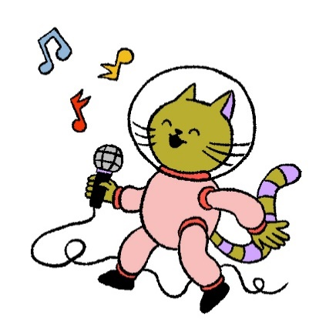
Word Scrambler
Rearrange the letters to answer this joke:
What type of music do cat-stronauts like to sing to?
P
E
T
N
U
N
S
E
Click here for a hint
Click here when you have solved this riddle

Slide 13
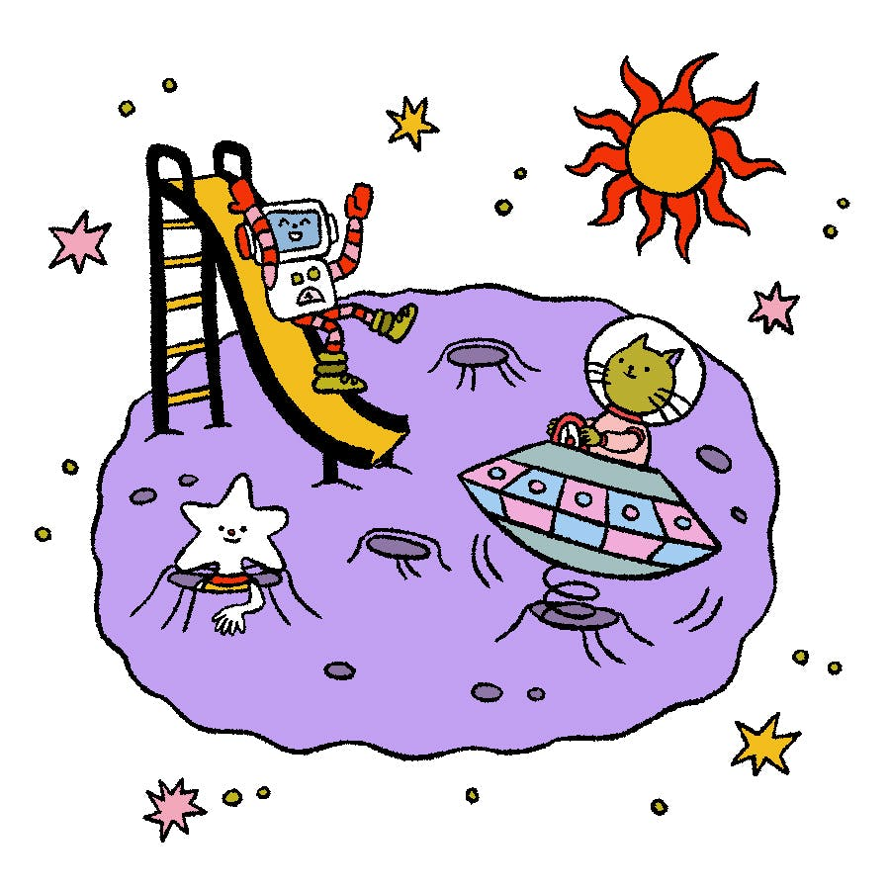
It sounds like the name of a planet!
Click here to go back to the word scrambler

Slide 14
“Neptunes!” you shout.
“Congratulations,” you hear from the speaker. “Please proceed into the second room.”
2
Click here to enter door 2
Number Cipher

Slide 15
Number Cipher
Use the legend below to solve the riddle by matching the numbers in the top row with their corresponding letters in the second row:
1 | 2 | 3 | 4 | 5 | 6 | 7 | 8 | 9 | 10 | 11 | 12 | 13 | 14 | 15 | 16 | 17 | 18 | 19 | 20 | 21 | 22 | 23 | 24 | 25 | 26
A | B | C | D | E | F | G | H | I | J | K | L | M | N | O | P | Q | R | S | T | U | V | W | X | Y | Z
What is the moon’s favourite type of book?
3 | 15 | 13 | 5 | 20
2 | 15 | 15 | 11 | 19
Click here when you have solved this riddle

Slide 16
“Comet books!” you shout.
“Congratulations,” you hear again. “Please proceed into the third and final room.”
3
Click here to enter door 3
Reverse Alphabet

Slide 17
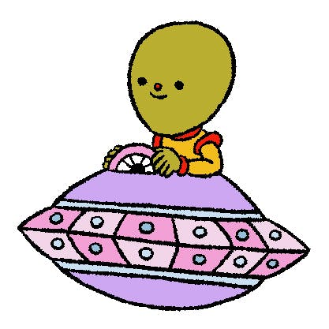
Reverse Alphabet
Use the legend to solve the riddle by matching the letters from the top row with their corresponding letters in the second row.
Z | Y | X | V | K | I | O
What does an alien drink when it has a tummy ache?
I | R | A | G | N | E | L
V | Z | K | V | I | Y
X | O | I | - | Z | I | K
Click here when you have solved this riddle

Slide 18

“Ginger ale-ien!” you shout excitedly.
Clink! A key drops from the ceiling. You pick it up, insert it into the lock, open the door and step outside.
“Phew! That was … uh … interesting,” you say.
As you hurry home, you hear, “3 … 2 … 1 … BLAST OFF!”
Clink!
Click here to exit
EXIT!

Slide 19


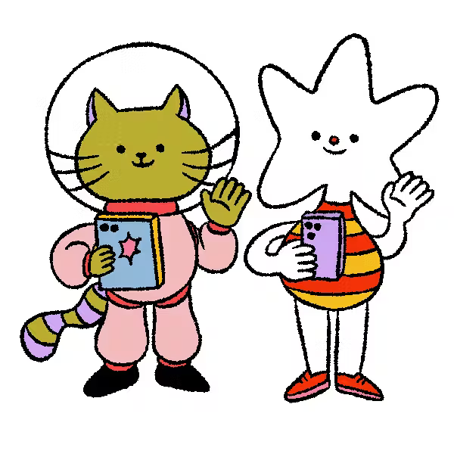
The End

