Slide 1
TD Summer Reading Club 2024
Join the Club!

Slide 2
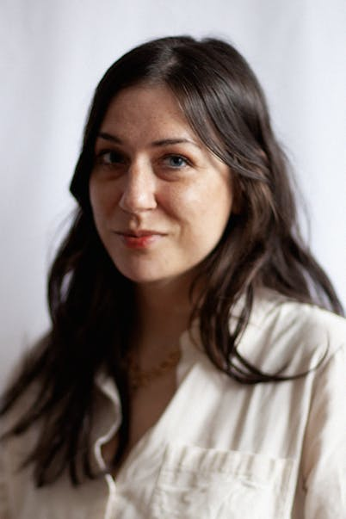
Audrey Malo
Meet the 2024 Artist
Audrey is a Montreal-based illustrator known for her quirky, friendly characters
Her artwork is featured on our notebooks, stickers and website
Audrey has worked with clients like The New York Times, Chevrolet, The Globe and Mail and Tim Hortons
Audrey loved reading the Goosebumps series as a kid, as well as comics such as Calvin and Hobbes

Slide 3
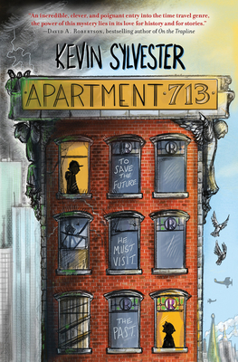
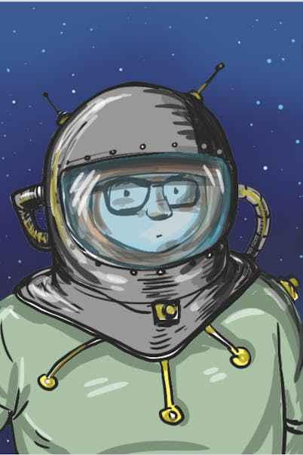
Kevin Sylvester
Meet the 2024
Web Comic Creator
Kevin Sylvester is the author and illustrator of many books, including the MiNRS trilogy, the Fabulous Zed Watson books and the Hockey Super Six series. He has also worked on picture books like Gargantua (Jr!): Defender of Earth
His web comic will be live on our website on June 10, 2024

Slide 4
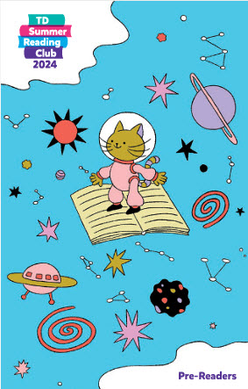
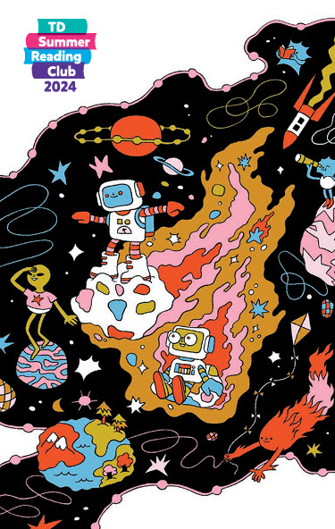
Notebooks
For kids ages 0—5
For kids ages 6—12

Slide 5
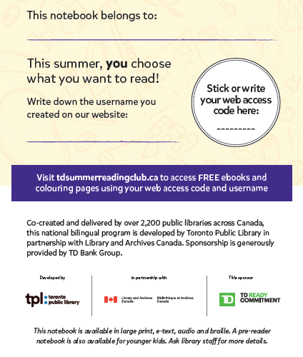
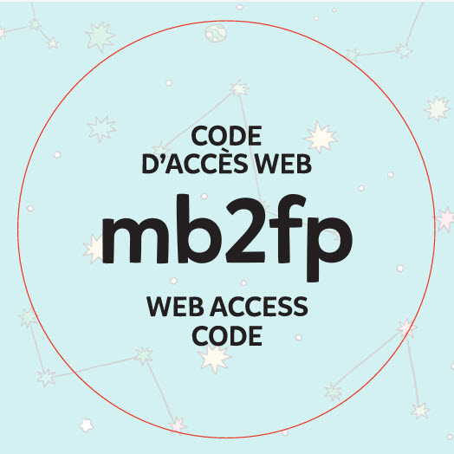
Web access code
Notes:
Note for editing: the web access code image will be swapped out with the new one once available

Slide 6
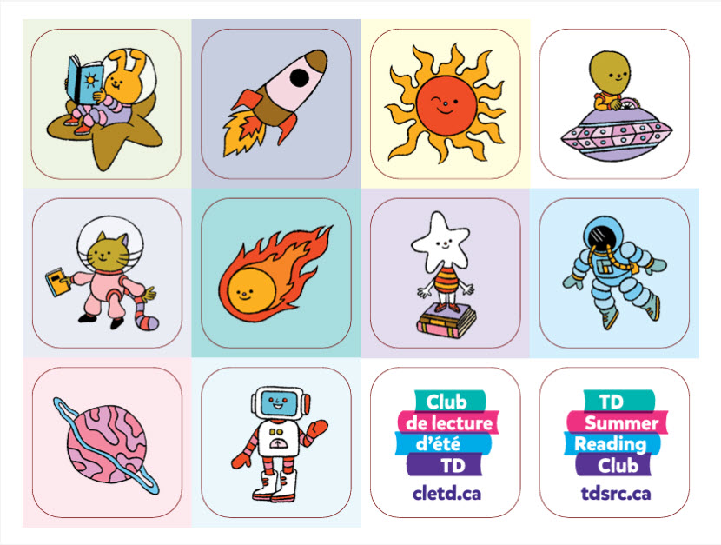
Notebook stickers

Slide 7
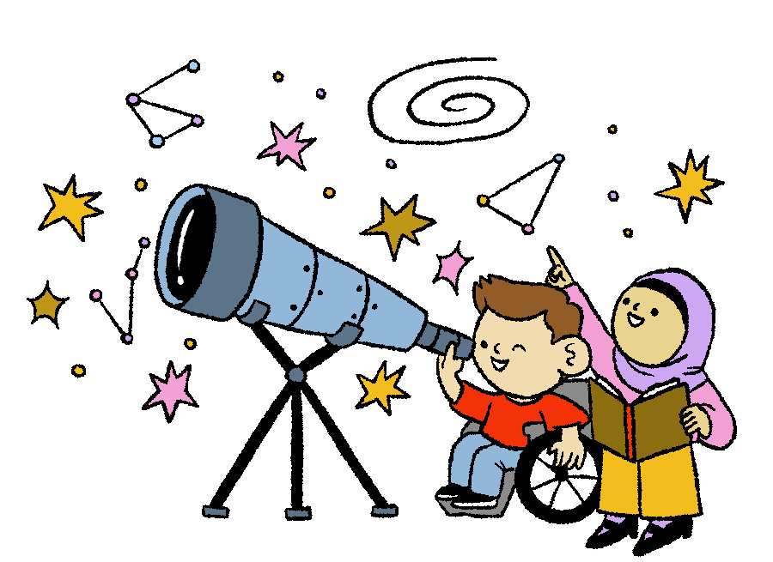
Kids’ Site
tdsummerreadingclub.ca
Highlights:
E-books
Web comic
Book recommendations
Online notebook
Battle of the books
Author and illustrator videos
Jokes
Silly stories
Story starters
Colouring pages
Trivia questions
Launches June 10, 2024

Slide 8
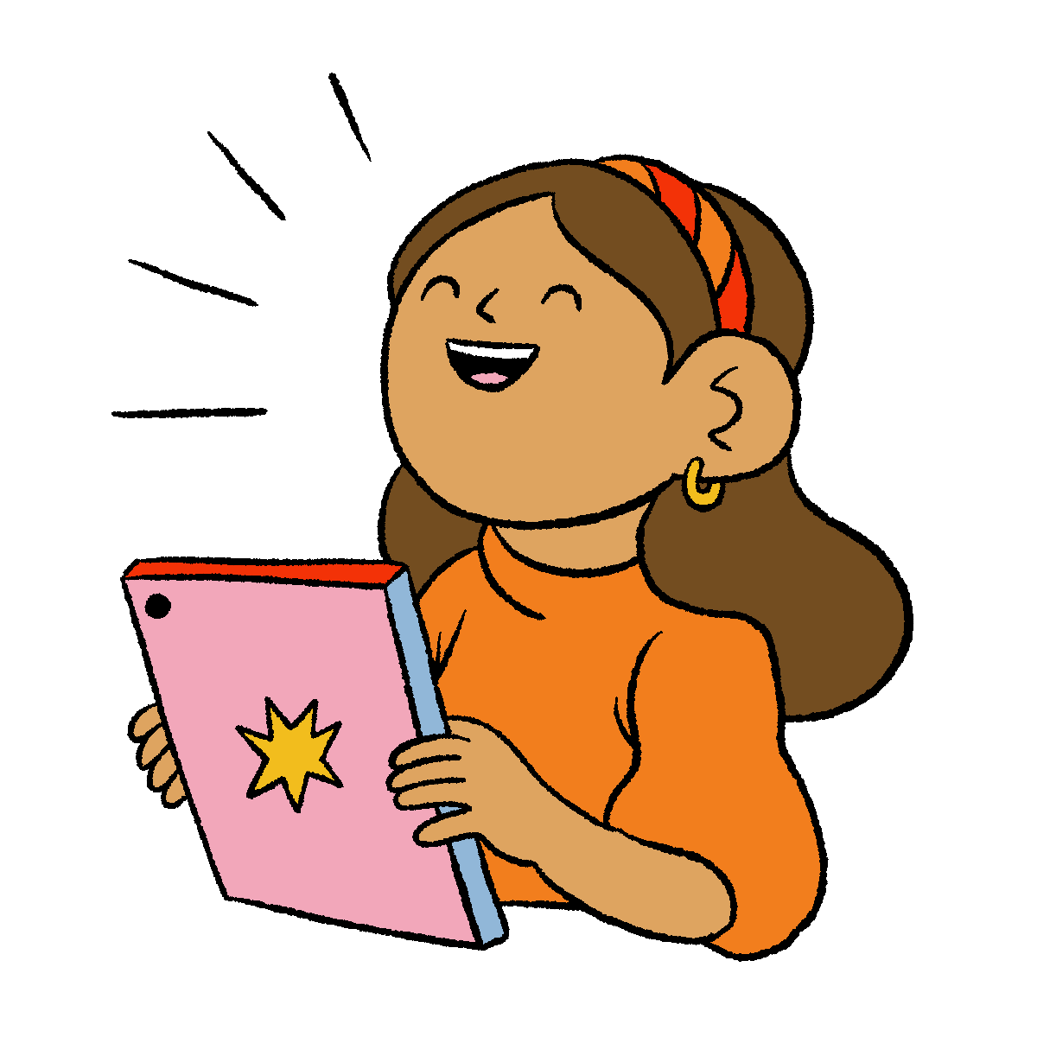
Jokes

Slide 9
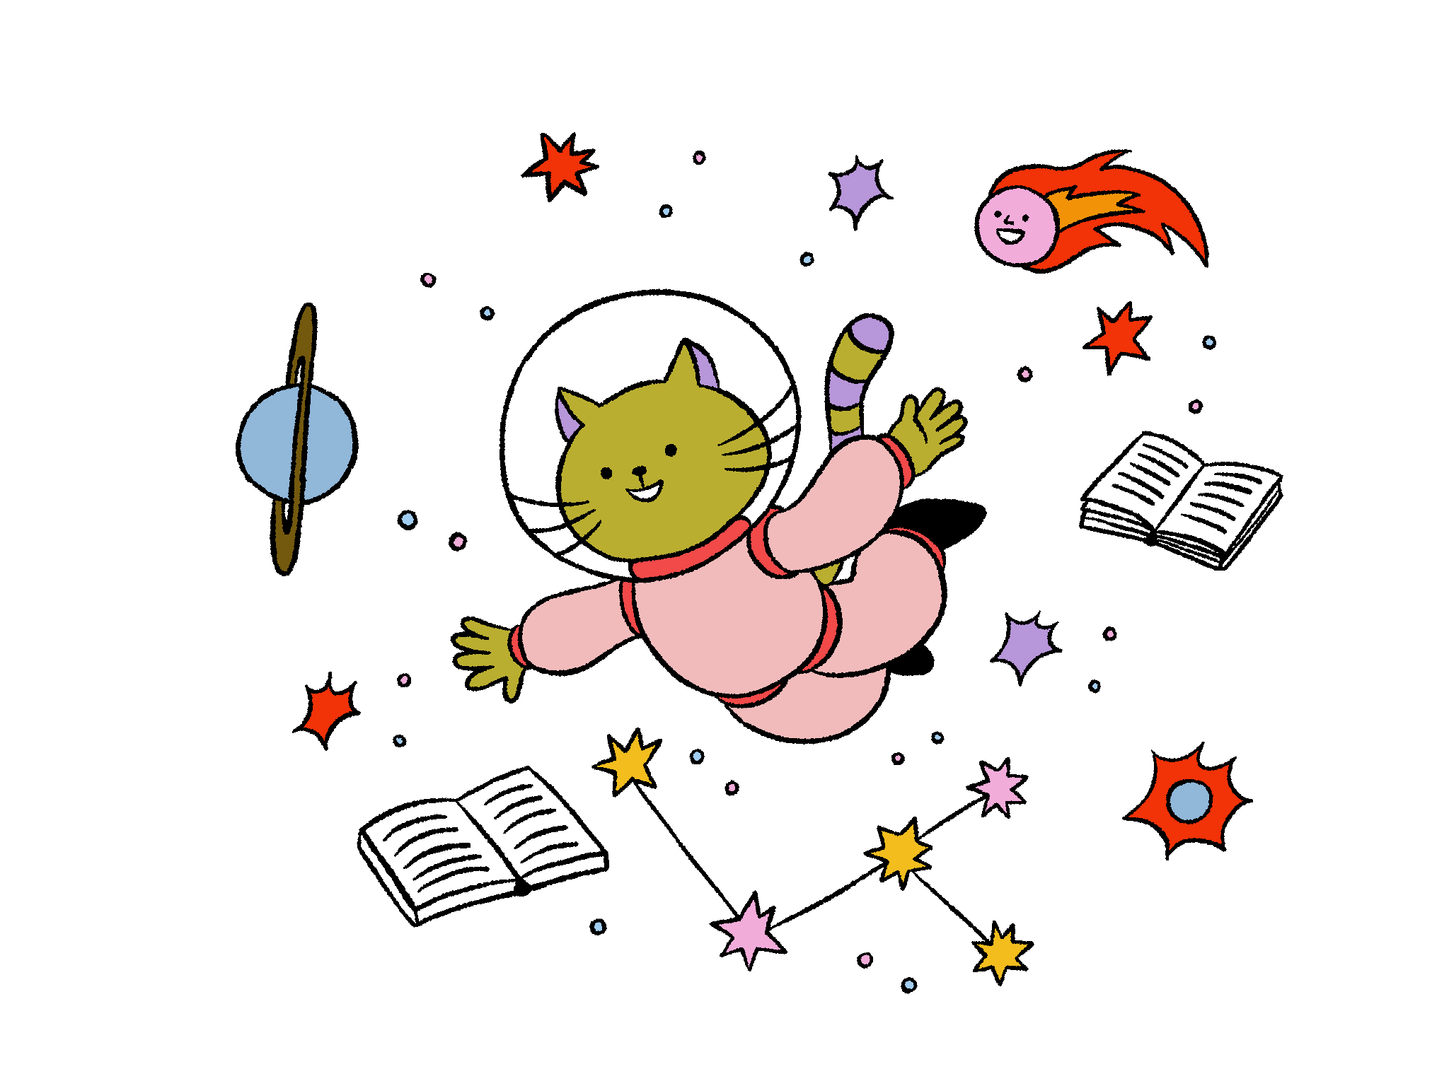
Why did the astronaut leave her wedding early?
She couldn’t wait for the honey moon

Slide 10
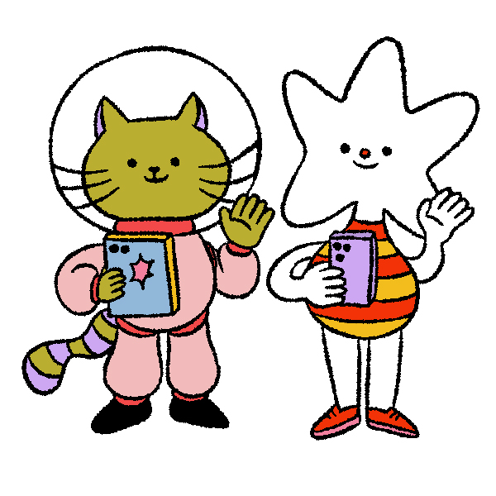
Why was Alien 6 afraid of Alien 7?
Because 7 8 9

Slide 11
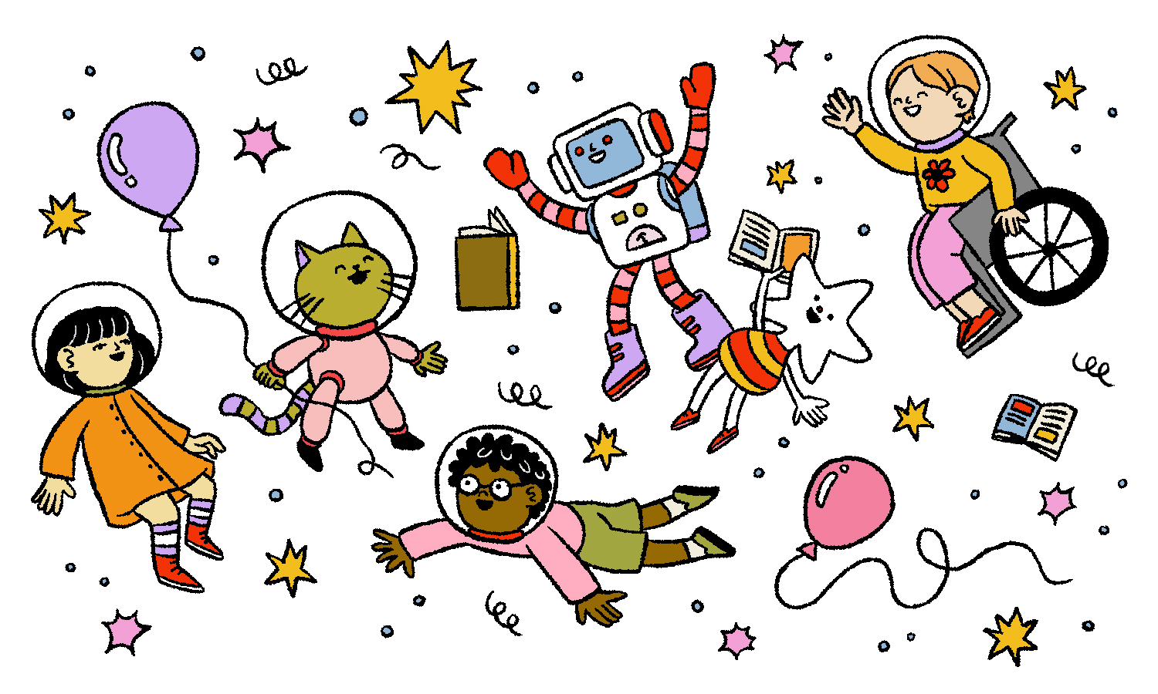
How do you know stars pay attention at school?
Well, they’re definitely brighter than most

Slide 12
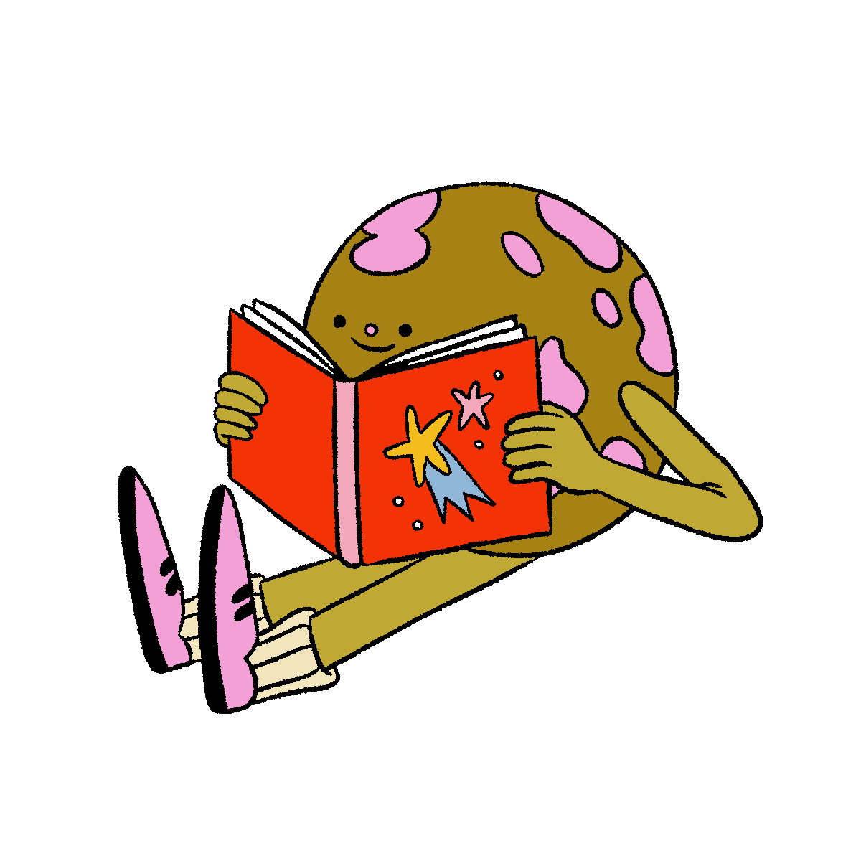
What kind of books do aliens love to read?
Comet books

Slide 13
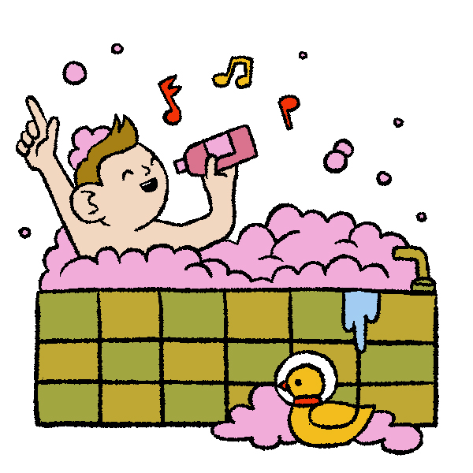
Why was the little alien so stinky?
He skipped his meteor shower

Slide 14
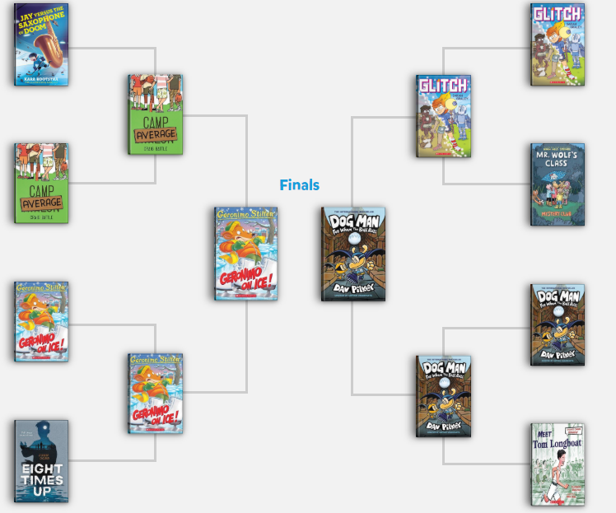
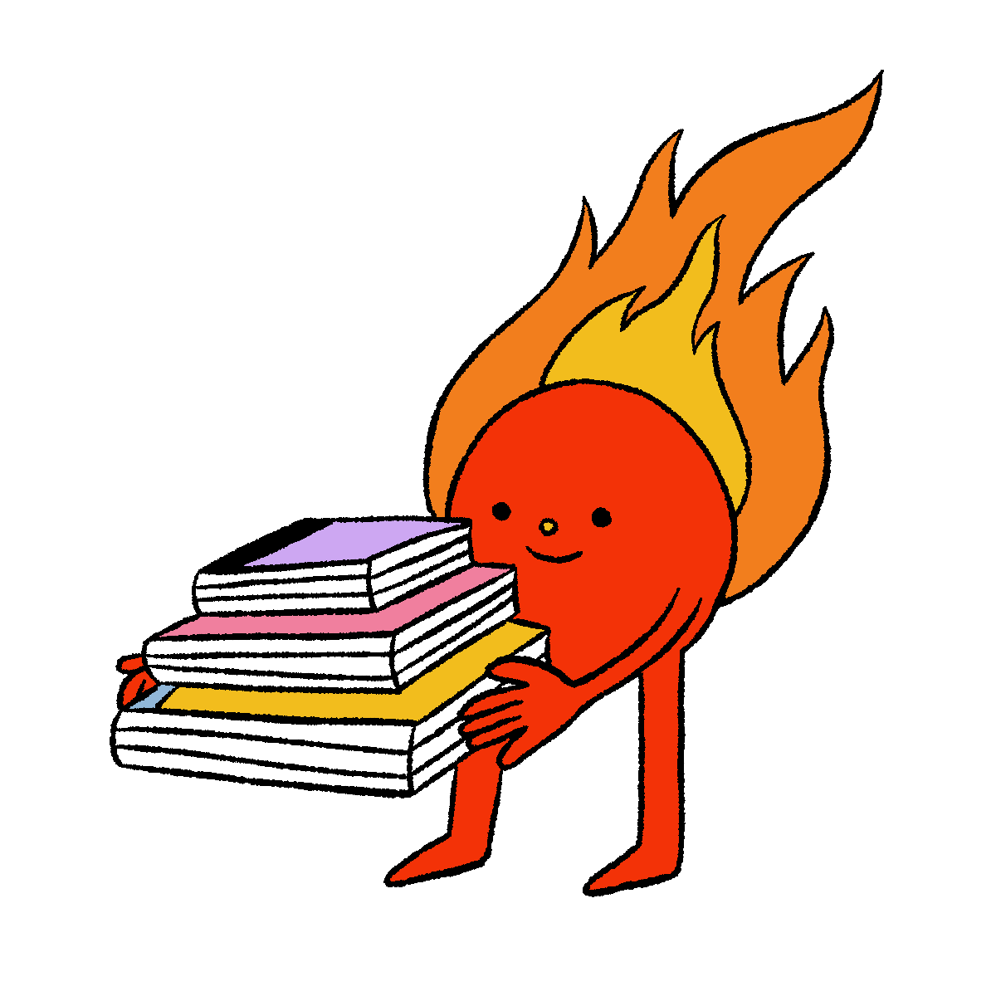
Battle of the Books
Get in on the action as eight books go head-to-head in this tournament style battle.
Vote for your favourite book each week until only one reigns supreme!
Books can be accessed in e-book
format too!
Notes:
This slide to be updated

Slide 15
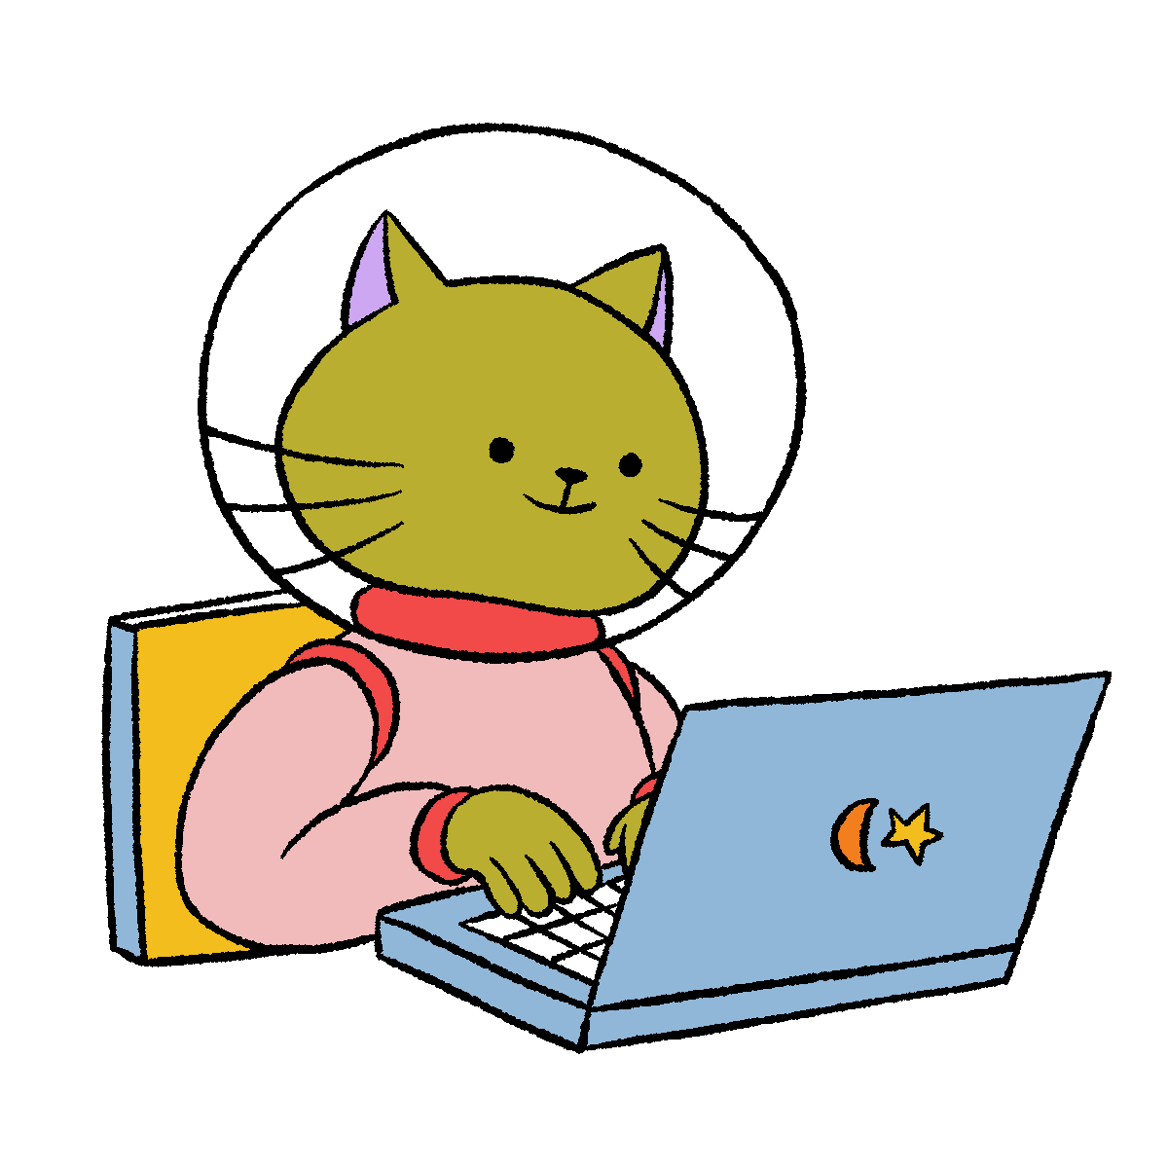
Trivia questions
The protective layer around our planet is called what?
a) Asteroid belt
b) Solar eclipse
c) Atmosphere
d) Milky Way
12 unique trivia questions with a new question released each week!

Slide 16
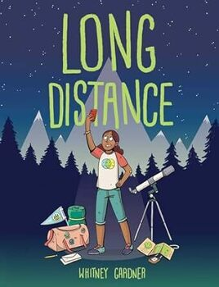
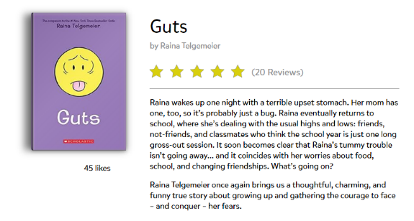
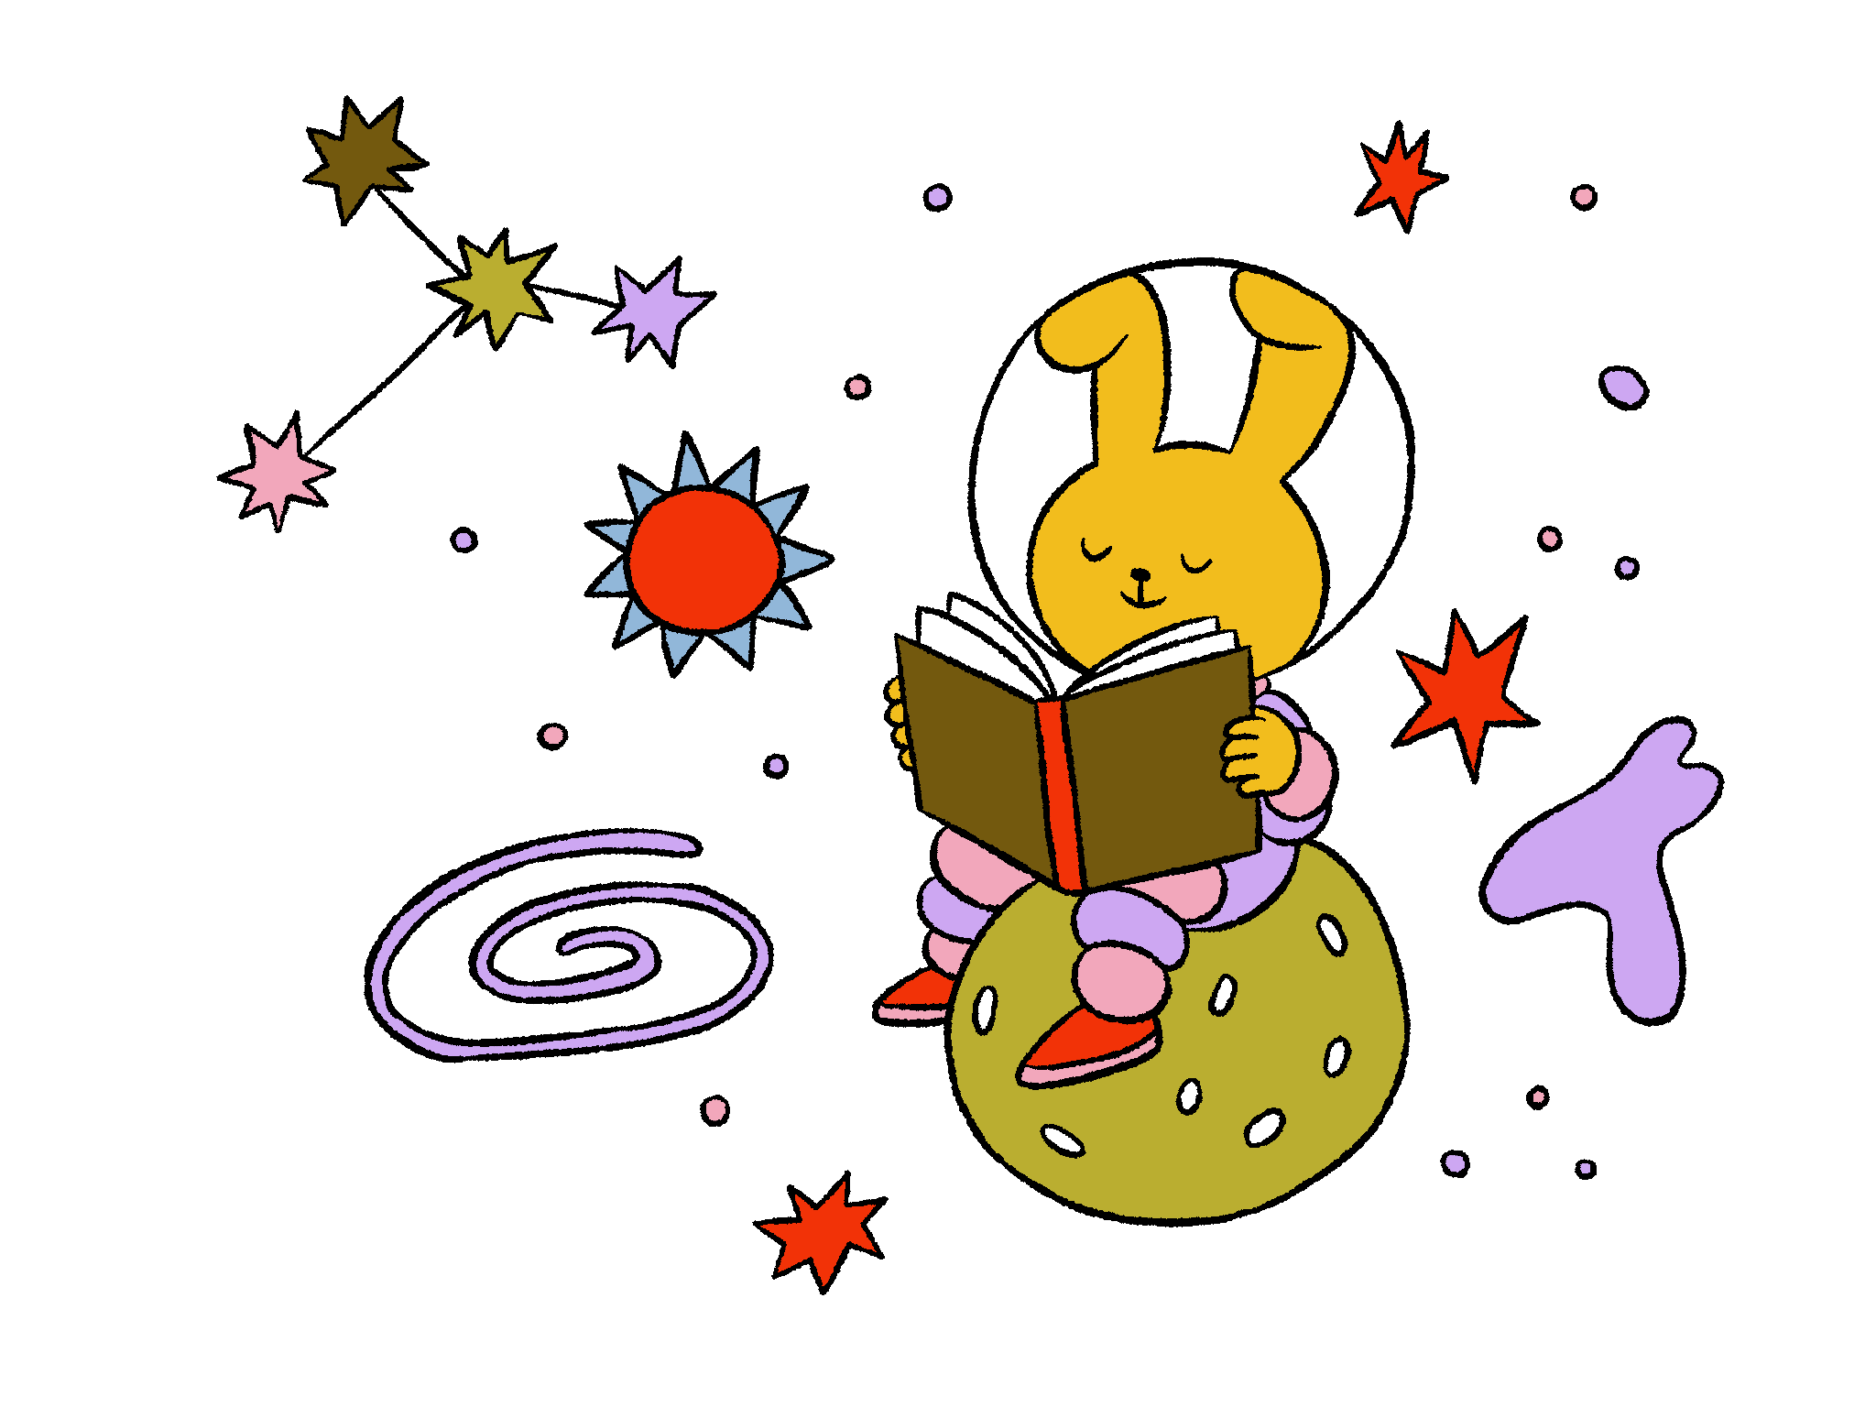
Read and review books
Read awesome books online
(all free,
all summer!)
Rate and review books you’ve read

Slide 17
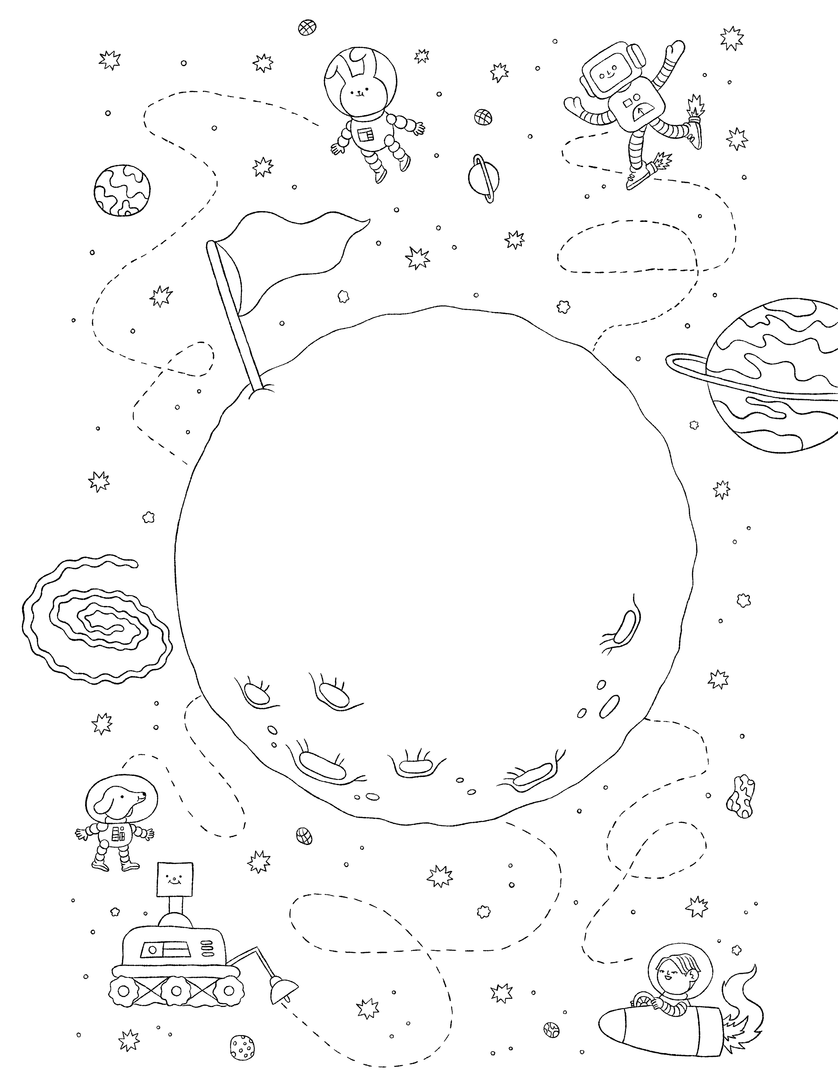
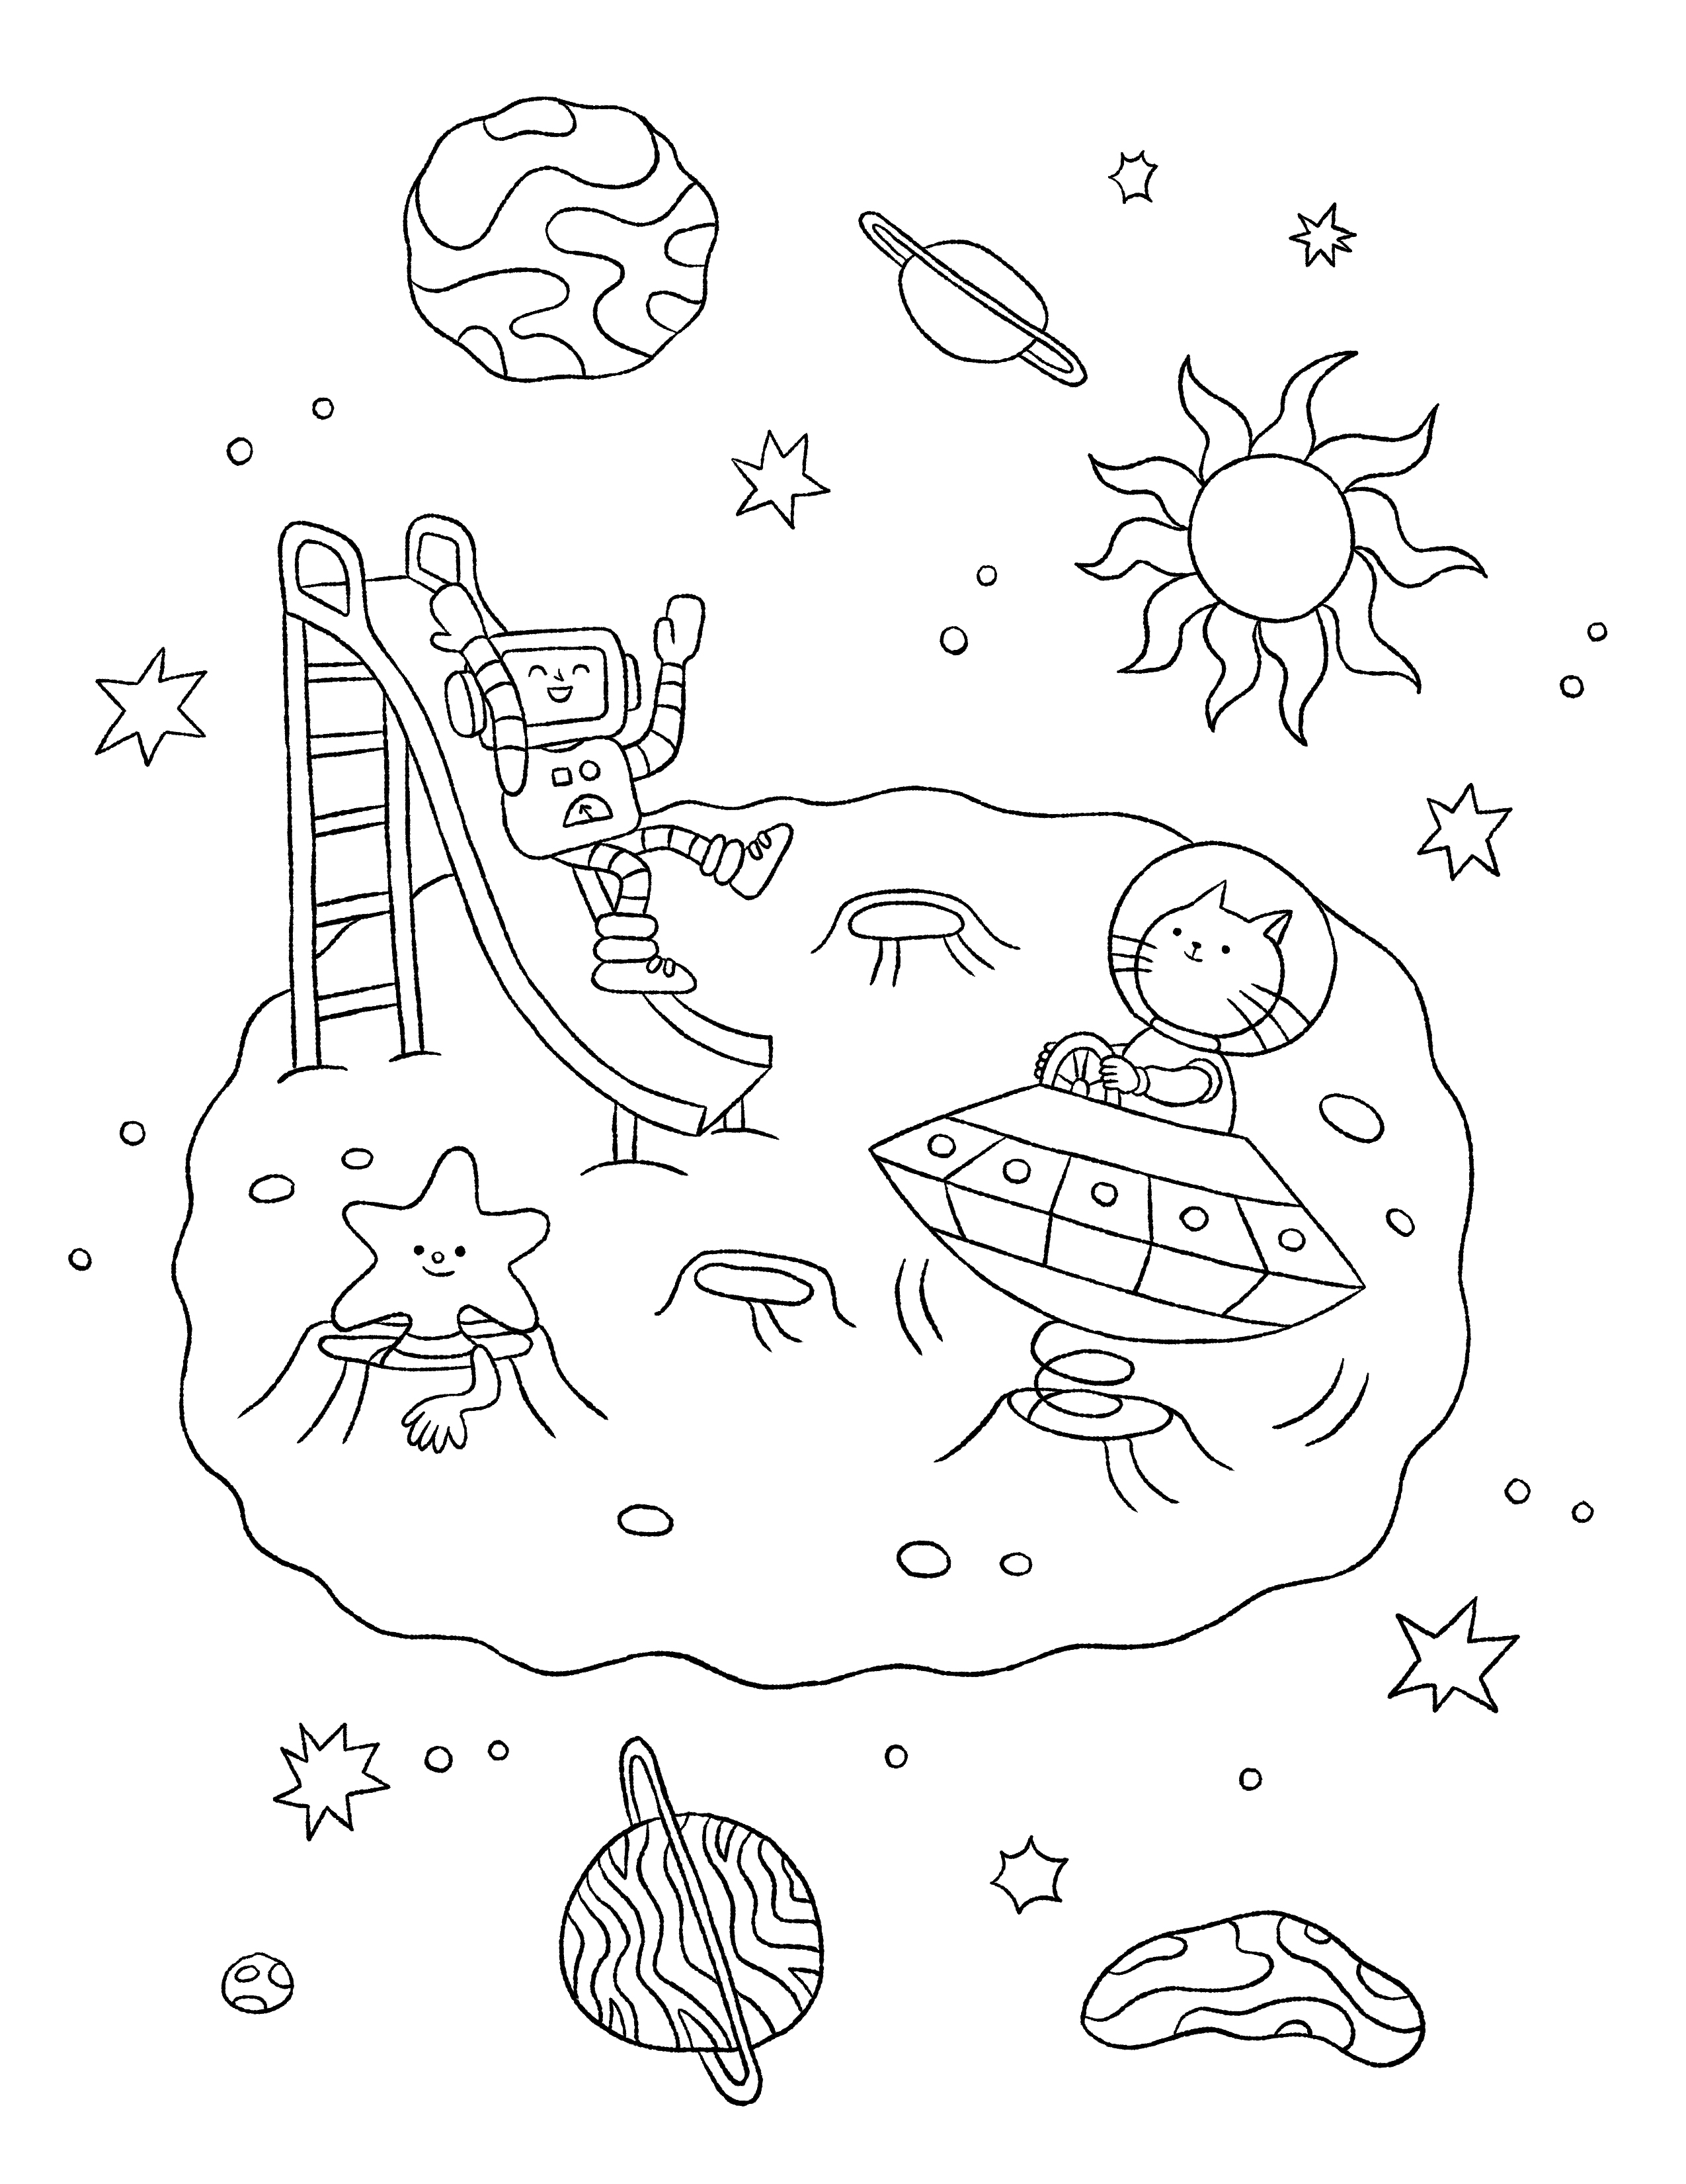
Even more fun online
Write your own story
Story Starters
Print colouring sheets
Silly Stories
Track reading in an online notebook

Slide 18
StoryWalk 2024
All across Canada
A story is coming to life!
Take a stroll through this year’s StoryWalk book, The Darkest Dark by Chris Hadfield, at select locations around the country.
A StoryWalk allows readers to explore a book as they physically move through a park or along a path.
Check out this 2021 StoryWalk recap video on YouTube to see it in action.
Notes:
Click on link to open 2021 StoryWalk trailer on YouTube as example

Slide 19
Themed Story times + Crafts
Star Fishing Story time
Plan a perfectly paired storytime!
Read Star Fishing by Sang-Keun Kim and create ‘fishing rods’ to catch some stars.
Find full instructions for this and more activities online.

Slide 20
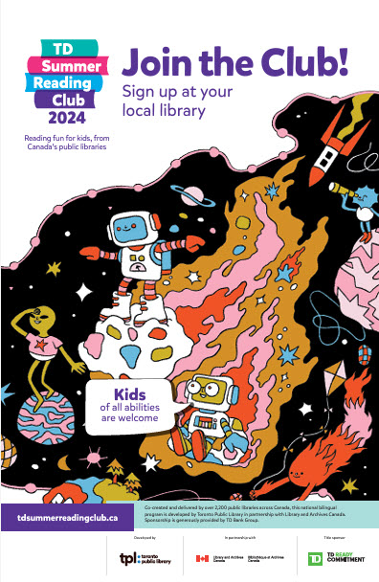
Thank you for being part of the 2024 TD Summer Reading Club!

Slide 21
Click here to enter program name
Insert a picture here by clicking on the icon below and then browsing and selecting the desired image. Crop the image to fit if needed.
Enter program date here…
Enter program description here…
Notes:
Library staff can add their own local program info here for the 2024 Club.

